Slide 1

Project 3 – A Covid study
Colin Roberts, Hannah Kollmann, Padmashiri Bhatta , Paul Anderson, connery hinson

Slide 2
The NIH (National Institute of Health), in an effort to be better prepared for the next pandemic, has commissioned a study looking into the factors that influenced COVID spread and mortality. The ask is for their team of analysts to visualize how COVID spread affected different populations of countries around the world, with population density and vaccination rates being factors. Also, the NIH has asked for an analysis of COVID mortality in these countries, along with those visualizations, and for the team to draw data-based conclusions that might allow us to be better able to withstand the impact of another pandemic
2020
COVID pandemic
2024
COVID now endemic
20xx
Possible next pandemic?

Slide 3
Process
Locate datasets that would support our project
Webscrape the Data using Beautiful Soup
Clean the data, using only aggregated, de-identified data that could not identify individuals
Create a SQL database to support our project
Using pandas, python, and a map application, develop visualizations from the data
Used a new library call Re to turn the df into json then to javascript for interactive visuals
Draw conclusions supported by the data
Discuss any limitations of the data
Potential recommendation for the next pandemic

Slide 4
SQL Database
Once the data were cleaned, we were able to create a simple SQL database in PostgreSQL with two tables. This data could be used later to access specific information about how countries fared during the pandemic :
Database schema : Query samples
CREATE DATABASE Project_3_covid_db
SELECT * CREATE TABLE covid_population( FROM covid_population
country VARCHAR(40) PRIMARY KEY NOT NULL,
total_cases BIGINT,
total_deaths BIGINT,
latitude DECIMAL(8,4), SELECT *
longitude DECIMAL(8,4), FROM covid_vaccinations
population BIGINT,
population_density INTEGER,
land_area BIGINT);
CREATE TABLE covid_vaccinations(
country VARCHAR(40) PRIMARY KEY NOT NULL,
vaccinations BIGINT);

Slide 5
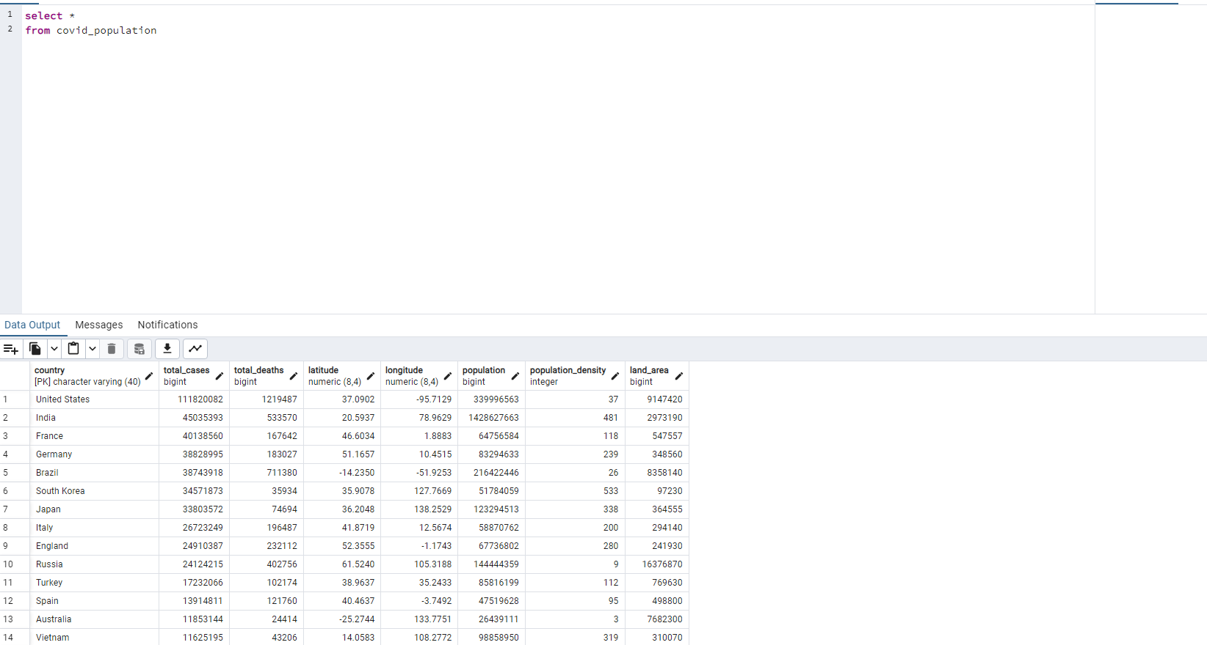
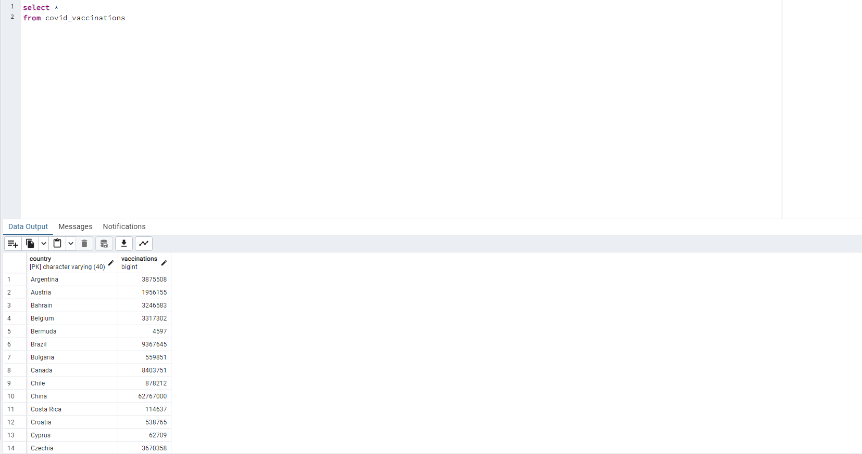
SQL Tables

Slide 6
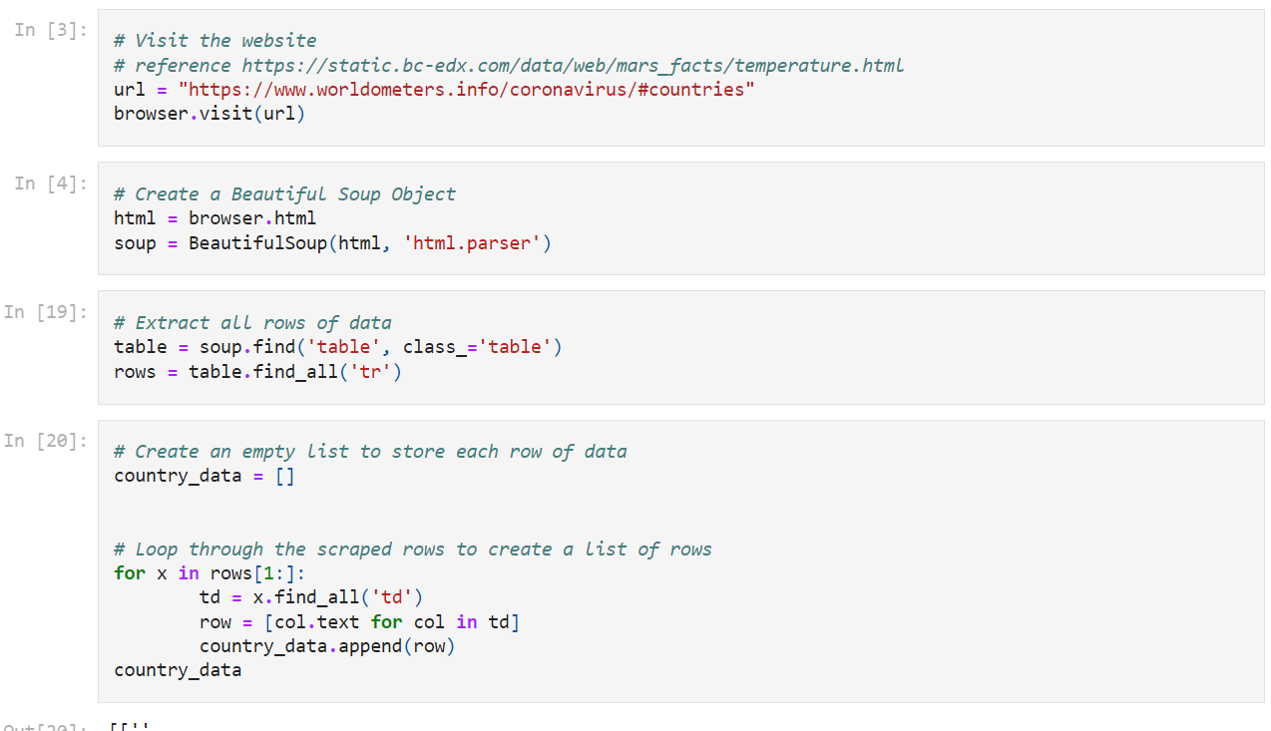
Covid by Country webscrape

Slide 7
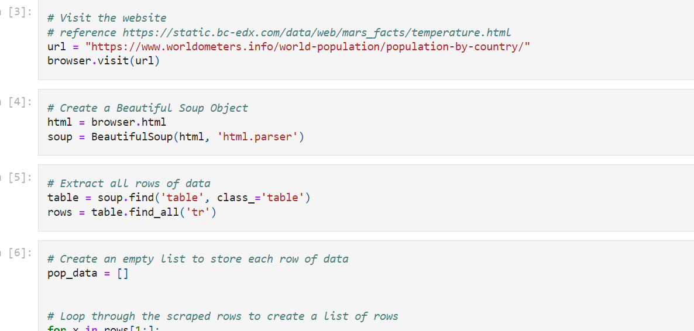
Population by Country webscrape

Slide 8
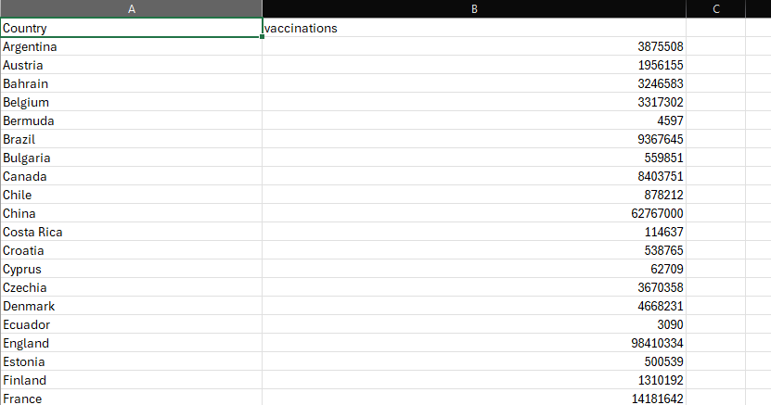
Vaccination By Country csv from Kaggle

Slide 9
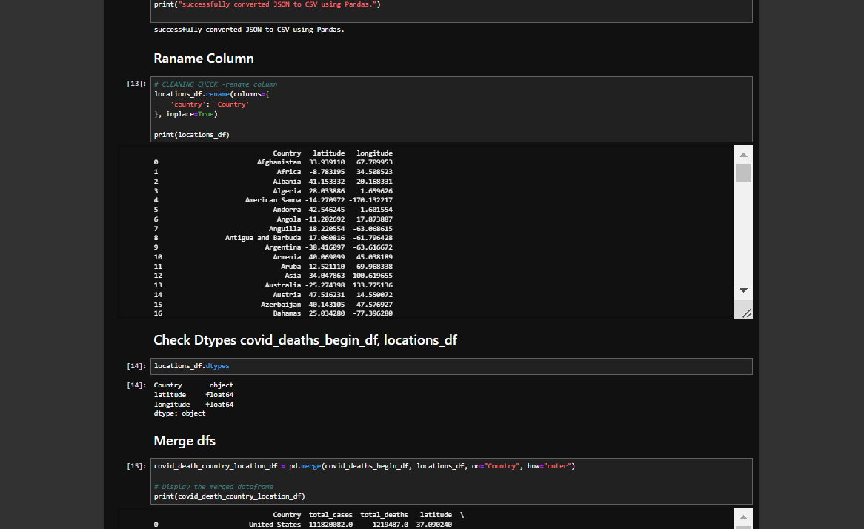
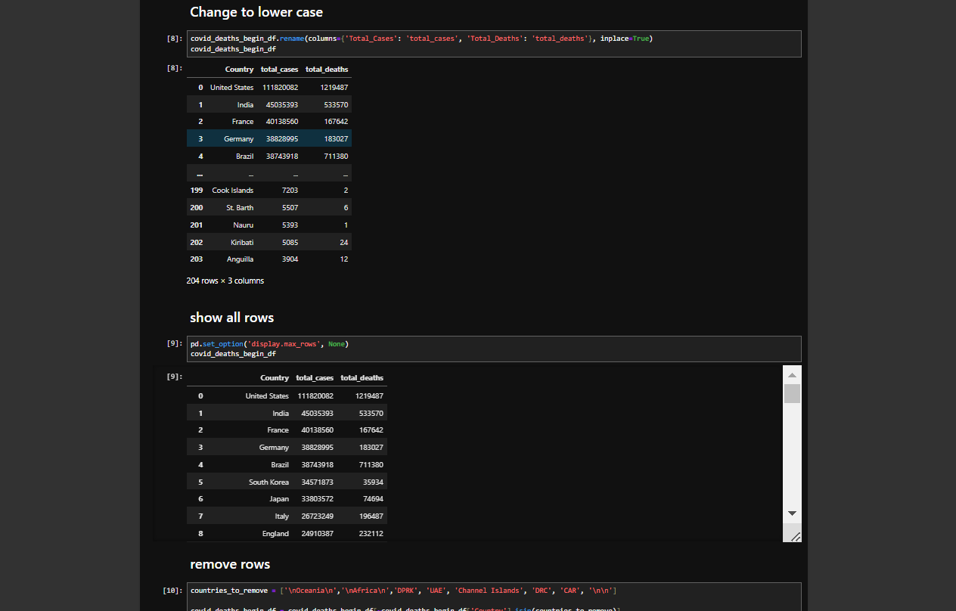
Created jupyter notebook to clean the data
In Jupyter Notebook I originally used a py library called dask to clean encoded dates from a Kaggle file with 400k rows with a quickness, ultimately the numbers were ridiculous and ended up scraping more data from another more reputable site. Changed names and data types since all of the scraped data started off as objects. Merged the data on Country and combined all of the data to a single df.

Slide 10

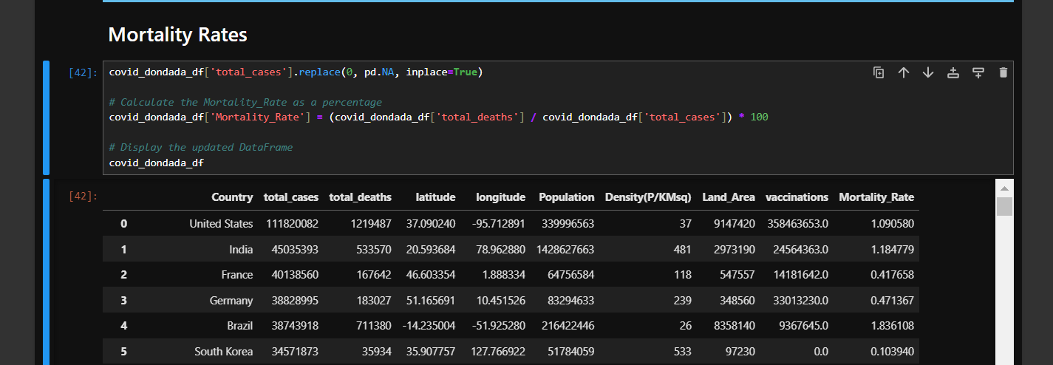
Created mortality rate in jupyter notebook
I created a mortality rates column for the df made up of deaths divided by cases times 100.

Slide 11
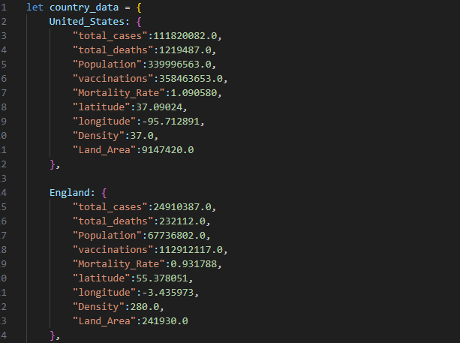
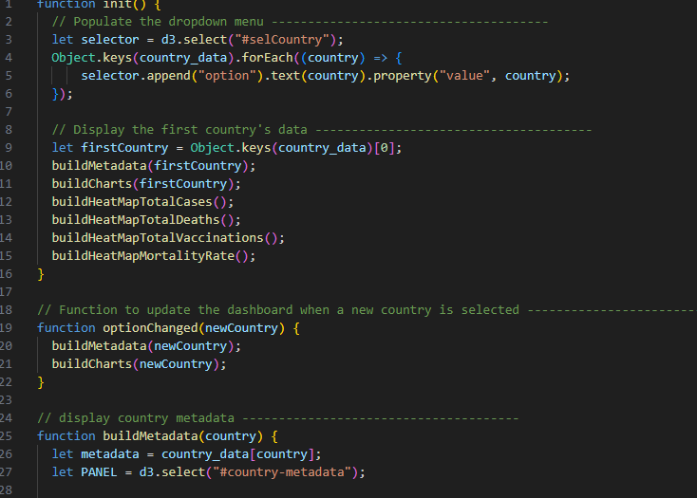
Interactive website data.js & app.js
I used another py library called re to convert the df to json the convert it to javascript where I wrote code for the html and css as well as the js to control the website.

Slide 12
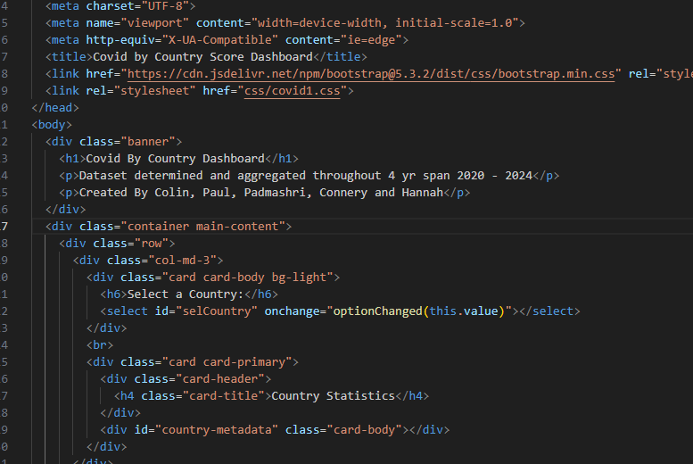
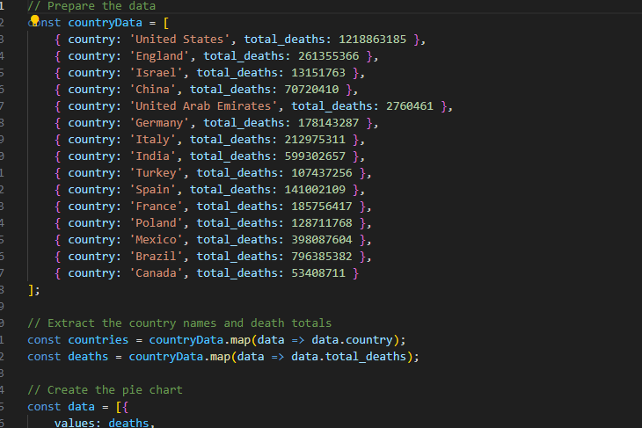
Interactive website html & piechart.js
I created piecharts and heat maps for the data to be displayed by mortality rate, deaths, cases, and vaccinations.

Slide 13
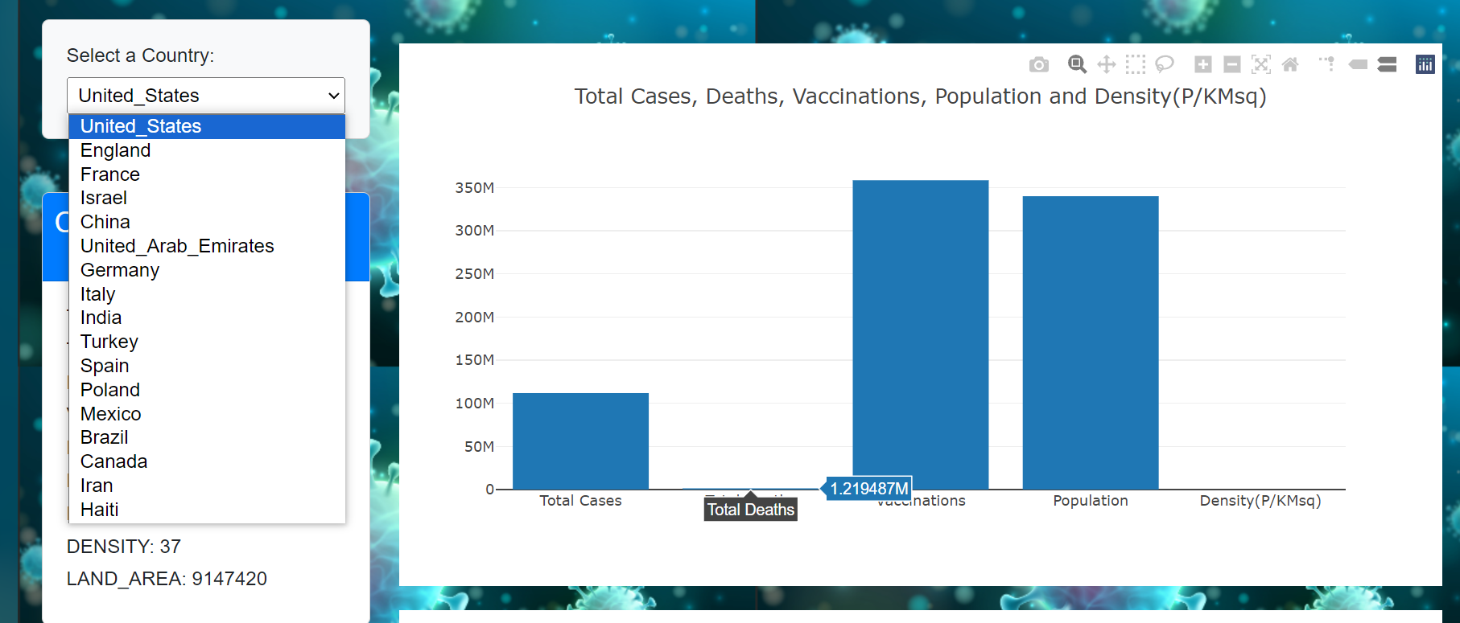
Interactive website drop down menu
The interactive website has a drop down to select a country to display the data in bar chart and graph.

Slide 14
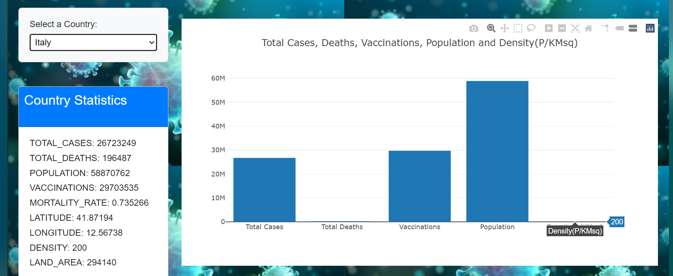
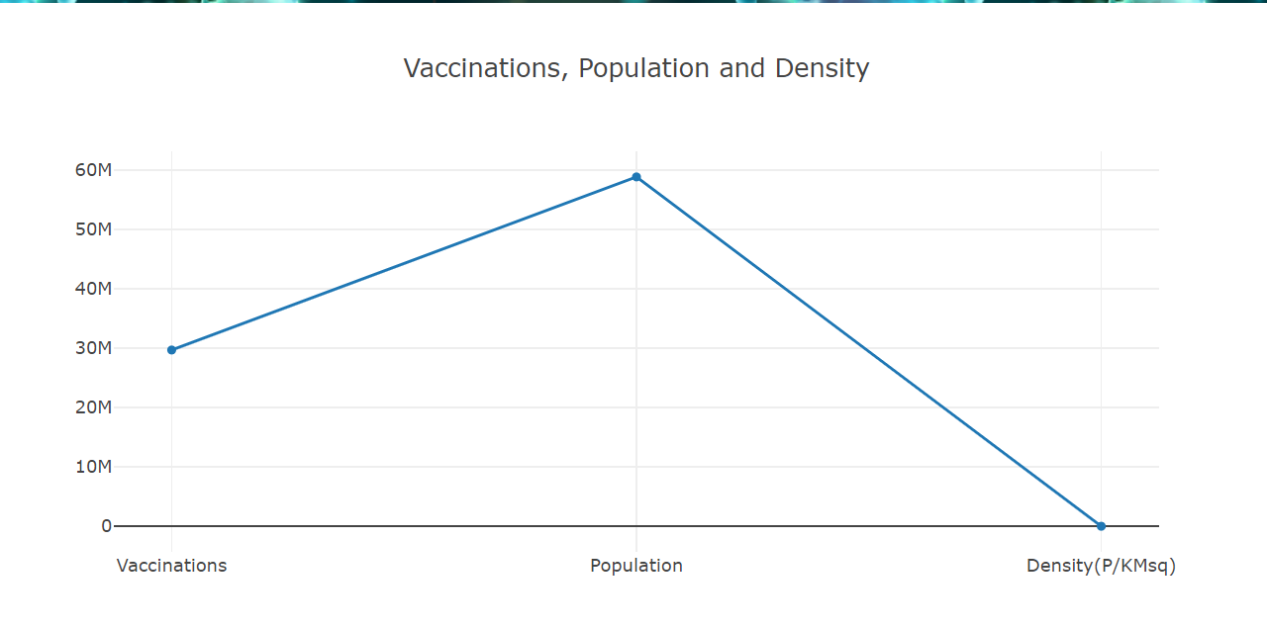
Interactive website card & graph
The United States had the most cases with 111 million. While China had the least in comparison with their population. The US with over 300 million vaccinations and the least being Russia and China with under 100 million for those that reported. While the mortality rates depend on vaccinations and reported cases when they were actually reported.

Slide 15
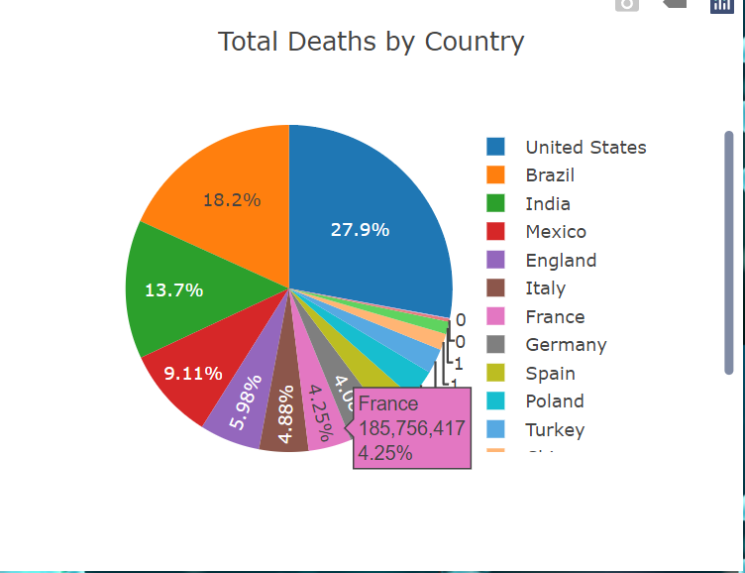
Interactive website piechart total deaths
When reported the most deaths in the world were the US 27.9% with Brazil 18.2% and India 13.7% close behind.

Slide 16
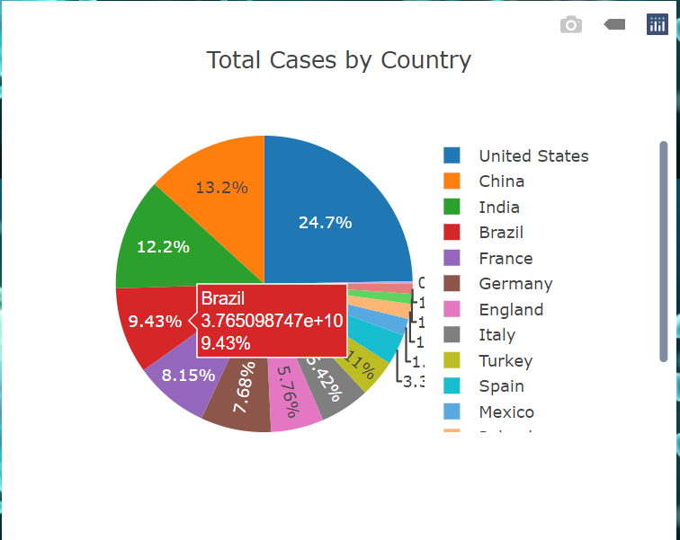
Interactive website total cases
Out of the total in the world the US reported the most cases 24.7% and China with 13.2% along with India 12.2%. With Canada , Israel and Poland having the least coming in at 1%

Slide 17
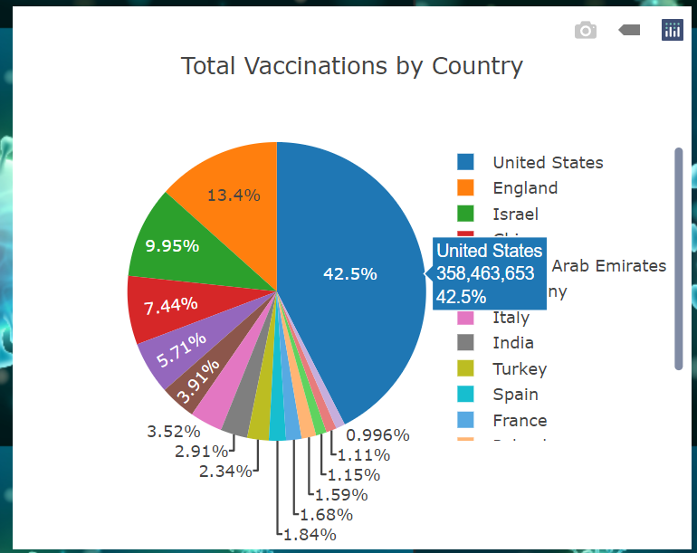
Interactive website vaccinations
Out of the Vaccinations the US has majority of the pie chart with 42.5% with England and Israel the closest behind ant around 10%.

Slide 18
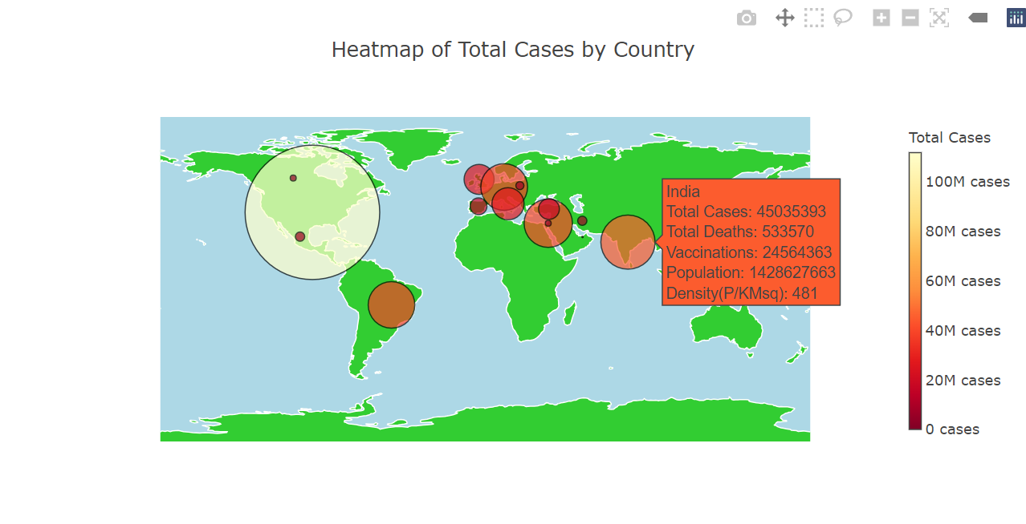
Interactive website total cases heat map

Slide 19
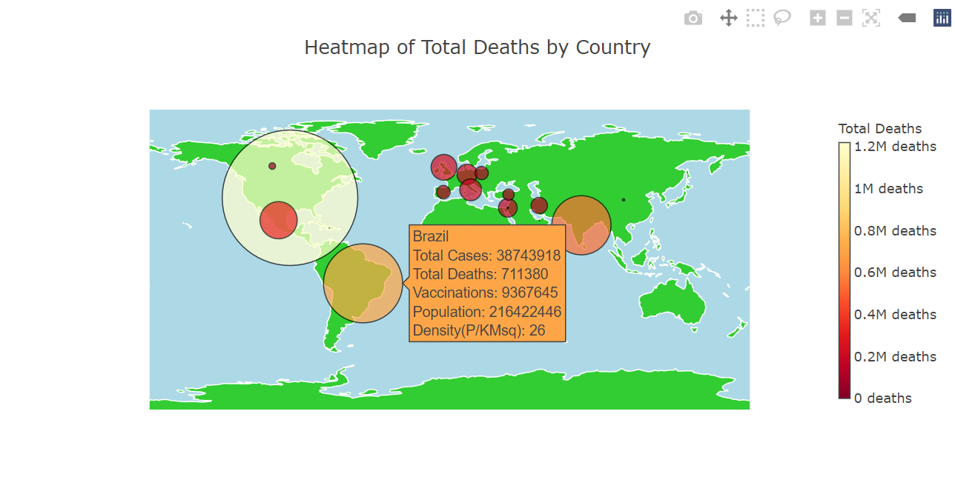
Interactive website total deaths heat map

Slide 20
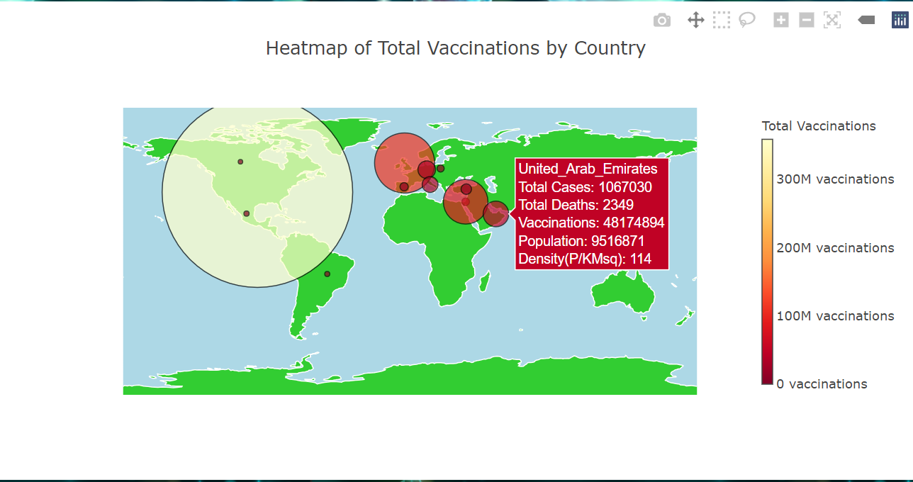
Data Visualizations Vaccinations heat map

Slide 21
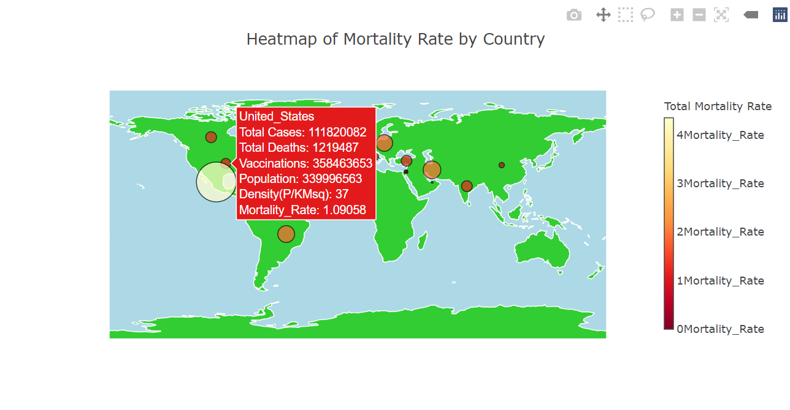
Data visualizations mortality Rates heat map

Slide 22
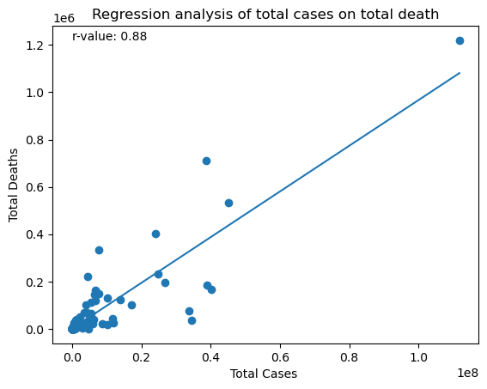
Data visualizations of Total cases on total death
This analysis helps us understand how COVID-19
spreads, and the strong correlation underscores
the importance of monitoring case numbers for
effective public health planning.

Slide 23
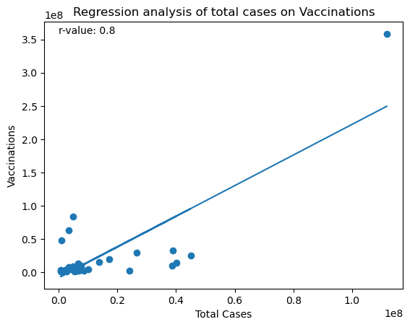
Data visualizations of Total cases on vaccinations
The scatter plot shows individual data points,
and the regression line summarizes the overall
trend. Policymakers can use this information to
plan vaccination efforts based on COVID-19
frequency.

Slide 24
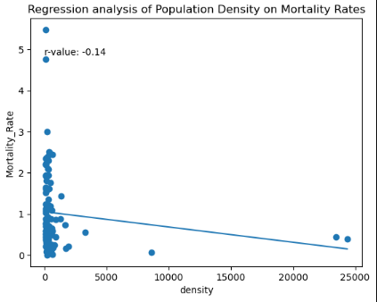
Data visualizations of mortality rate on pop density
Top 100 population density vs Mortality Rates

Slide 25
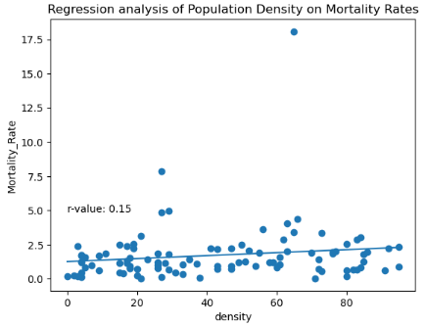
Data visualizations of mortality rate on pop density
Low 100 population density vs Mortality Rates

Slide 26
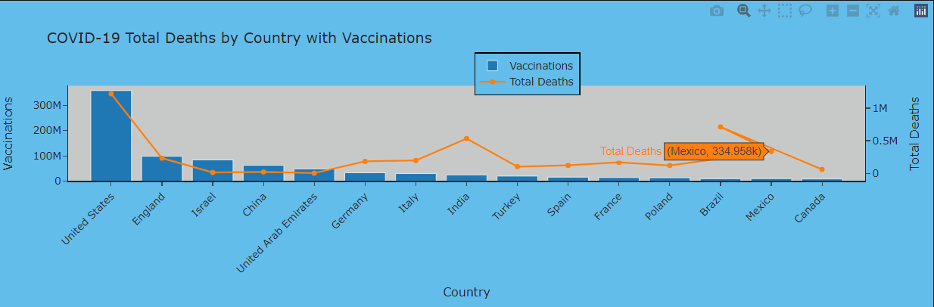
Data visualizations of deaths with vaccination by country

Slide 27
conclusions
As we would expect, the data say that more cases positively correlates with more deaths
There is also a positive correlation between population density and mortality rate, especially among the lower density populations. It appears that once a certain density was reached, higher densities did not much impact the number
Strangely, the data do not support decreased mortality and case load with increased vaccinations.
The visualization also tell us that vaccinations are not the only factor is decreasing mortality

Slide 28
Limitations of the data
Vaccine reporting may also correlate with higher levels of reporting for the virus itself. Both vaccinations rates and case load appear higher in developed countries, with more reporting capability overall
Countries with authoritarian regimes seem less likely to report cases and deaths, so the numbers were likely not accurate across the board
Further studies might include the effects of mitigation measures like separation on the pandemic. No doubt this played a large role, especially before vaccines were able to be developed
Testing efficacy will vary from country to country, resulting in skewed data

Slide 29
Recommendations based on the data
One recommendation that would be supported by the data would be decreasing the density by implementing separation policies. This was done with varying degrees of success in the last pandemic
Vaccines should be more closely studied. There were several available, and clearly, not all of them worked as well as some of the others
Early detection / accurate testing plays a huge role in mitigating the effects of the pandemic
Educating citizens about the importance of vaccines and other measures, like separation is also important. In some countries, it is difficult to combat false information

Slide 30
Questions?

